Slide 1


Online Notes
VIGNESH G

Slide 2


Project Overview
The Online Notes App is a secure, user-friendly platform that allows users to store, access, and manage their notes from anywhere.
Built using Core PHP, ensuring fast and secure note-taking capabilities.
"Your notes with you, wherever you go."

Slide 3
Core Features
Secure login and account creation via email, with password recovery and the ability to change email using PHPMailer.
Create, update, and delete notes with ease using a simple interface.
Organize notes by date or categorize them for better structure.
Optimized for both mobile and desktop users for a seamless experience across devices.
User passwords are encrypted using SHA256 for enhanced security.

Slide 4
Technology Stack
Front End: HTML, CSS, JavaScript
Back End: PHP
Database: MySQL (PhpMyAdmin)
Version Control: Git

Slide 5
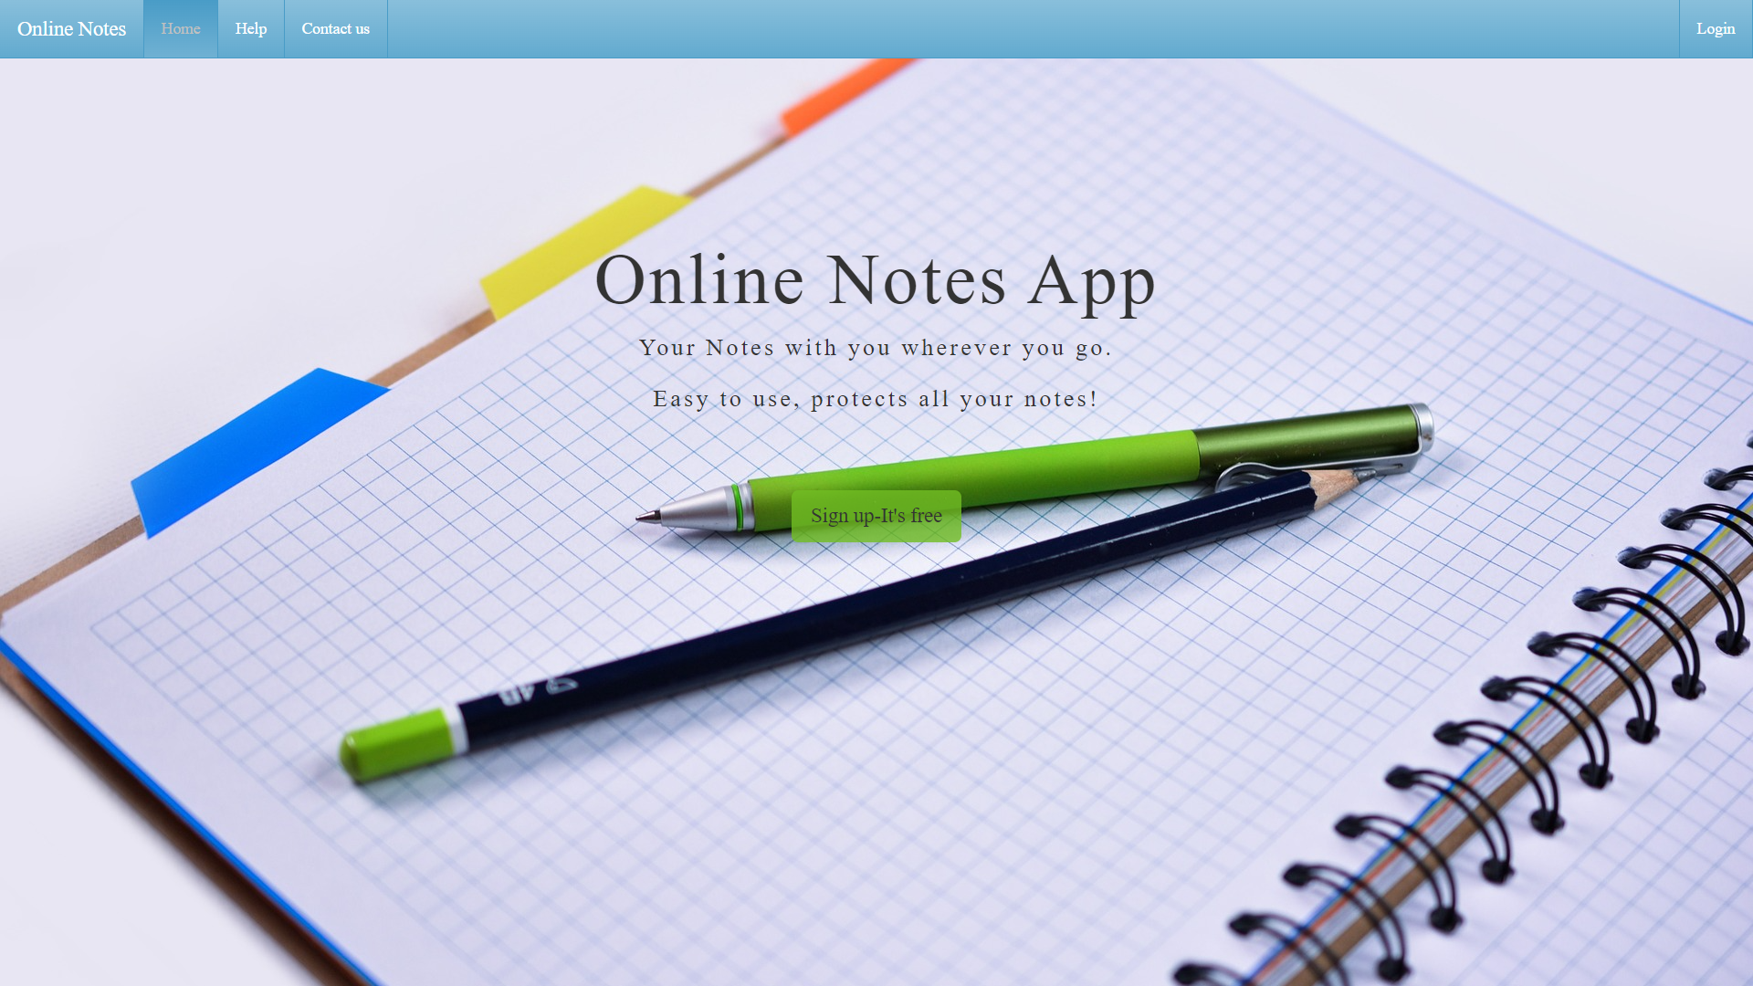
Login/Signup Page
The user authentication system allows new users to sign up using their email and password, while existing users can log in securely.
A forgot password feature is also available, providing users a simple way to recover their account via email.

Slide 6
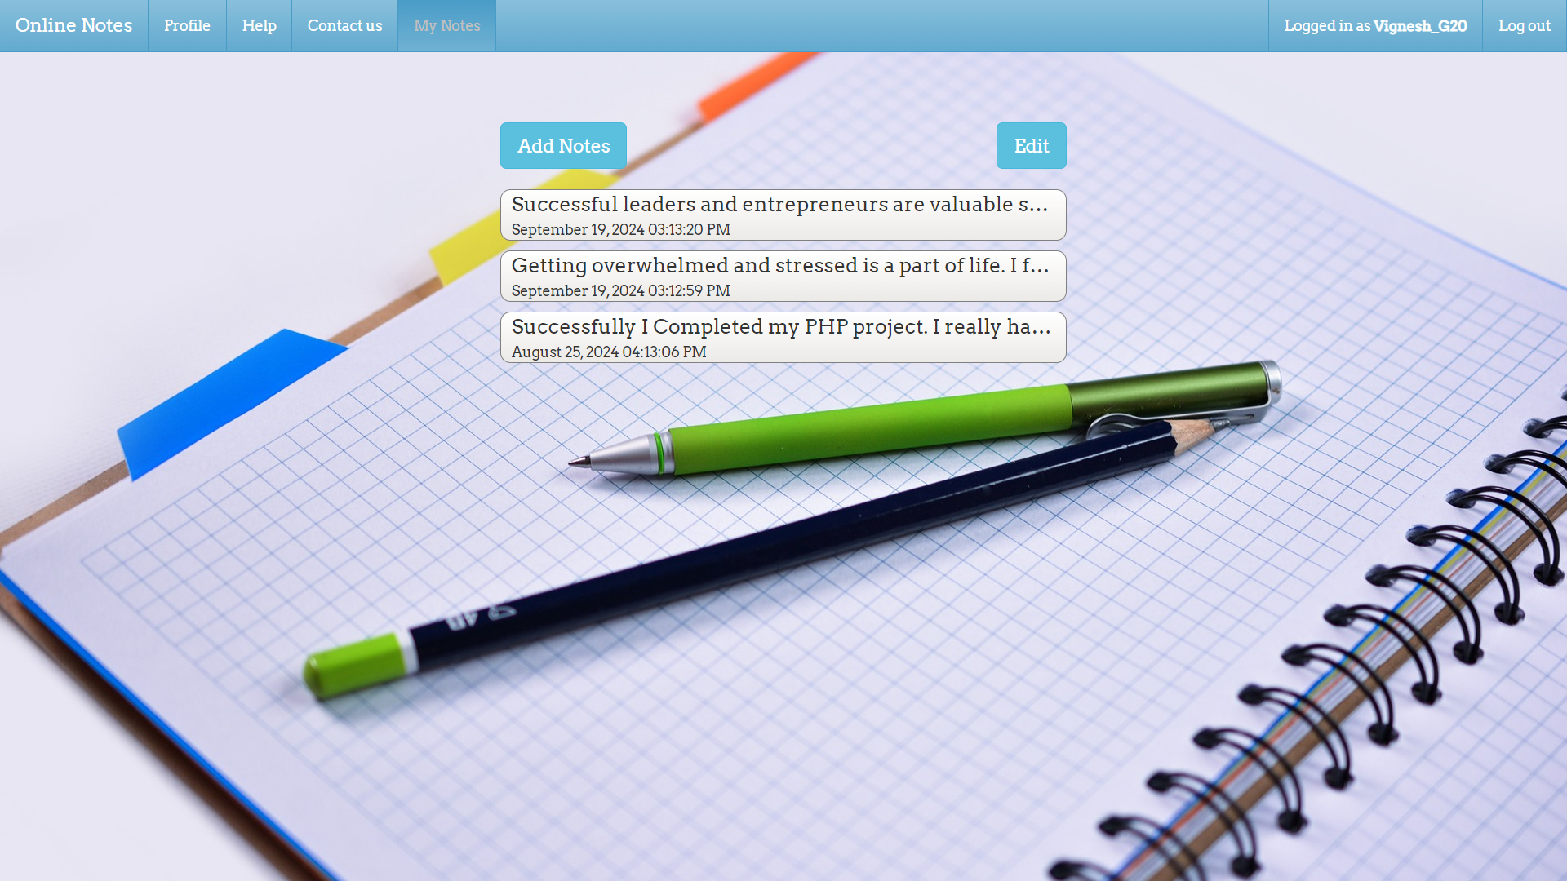
Home Page
After logging in, users are directed to the home page where all their notes are displayed.
Notes are presented in an organized manner, sorted by creation date or last updated. Users can easily manage their notes from here.
A clean interface allows for quick access to create, edit, or delete notes.

Slide 7
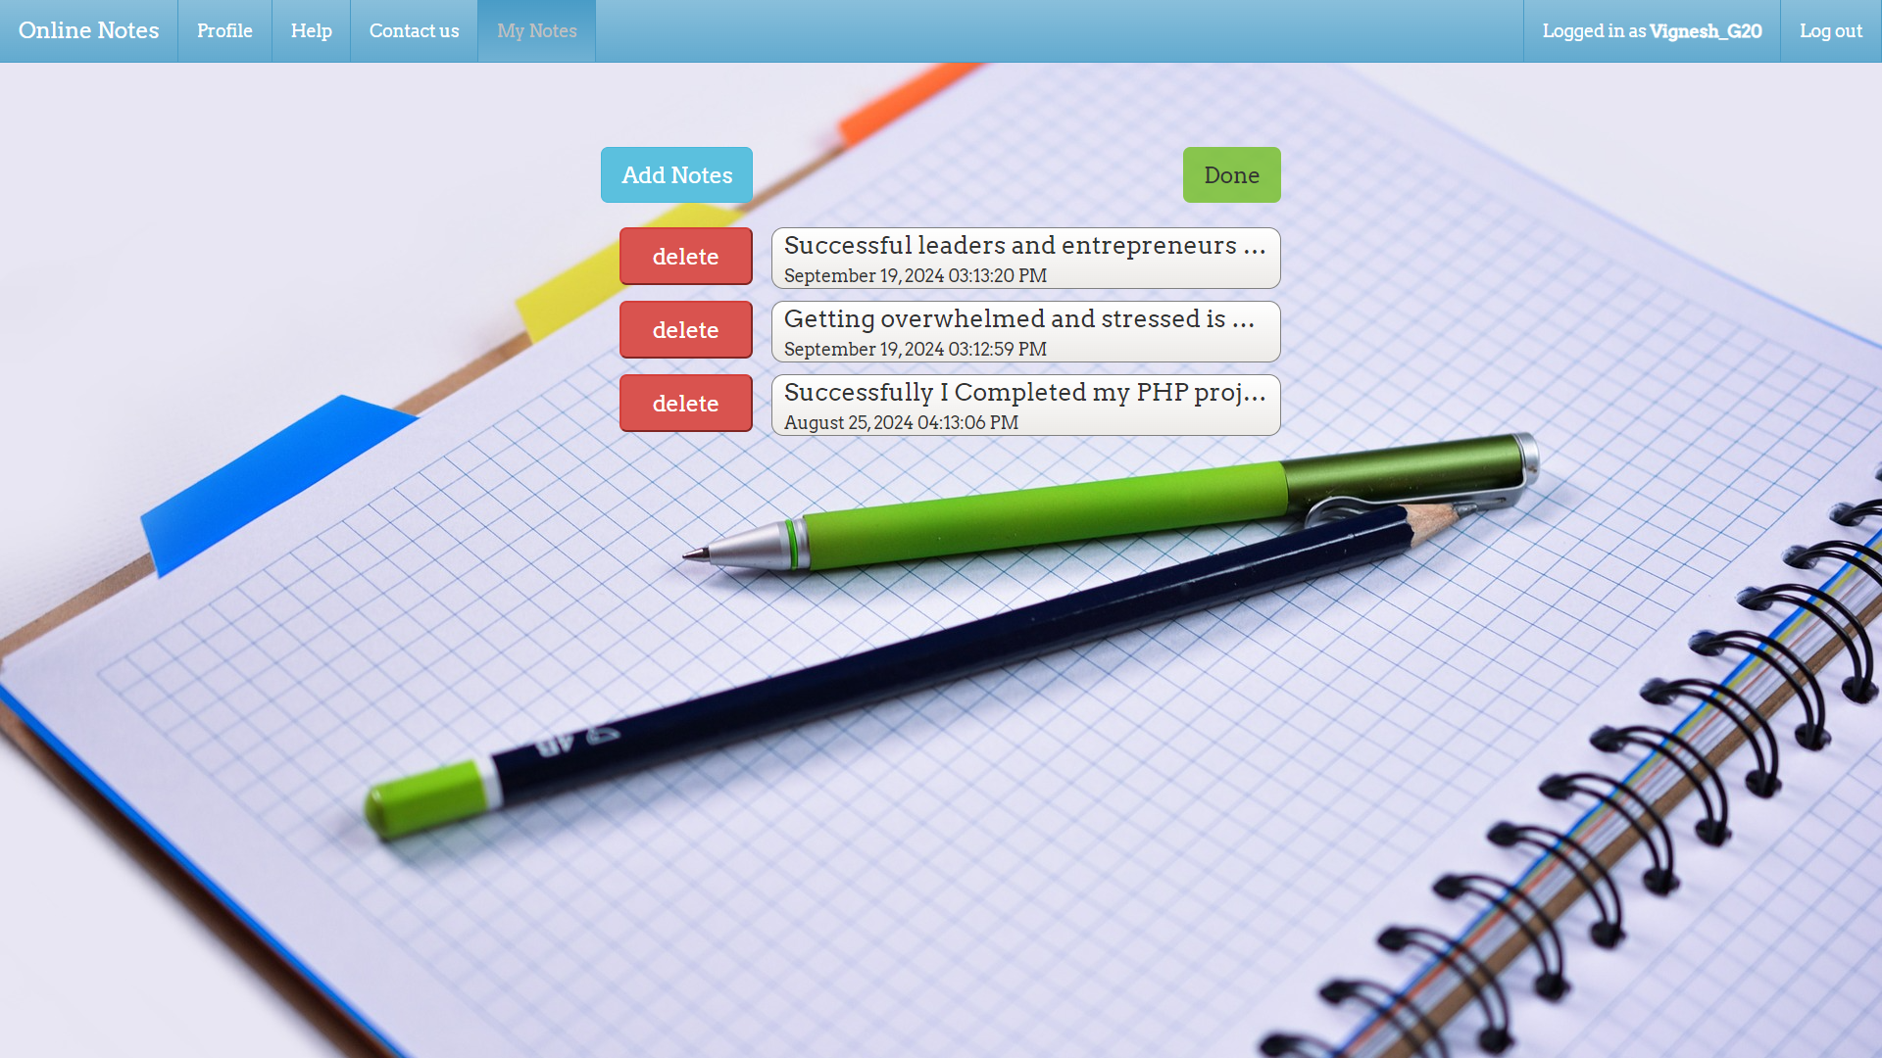
Delete Notes
Users can delete any unwanted or old notes with a simple click.
A confirmation prompt ensures that users don’t delete notes by accident.
This feature provides a clean and clutter-free environment for managing notes.

Slide 8
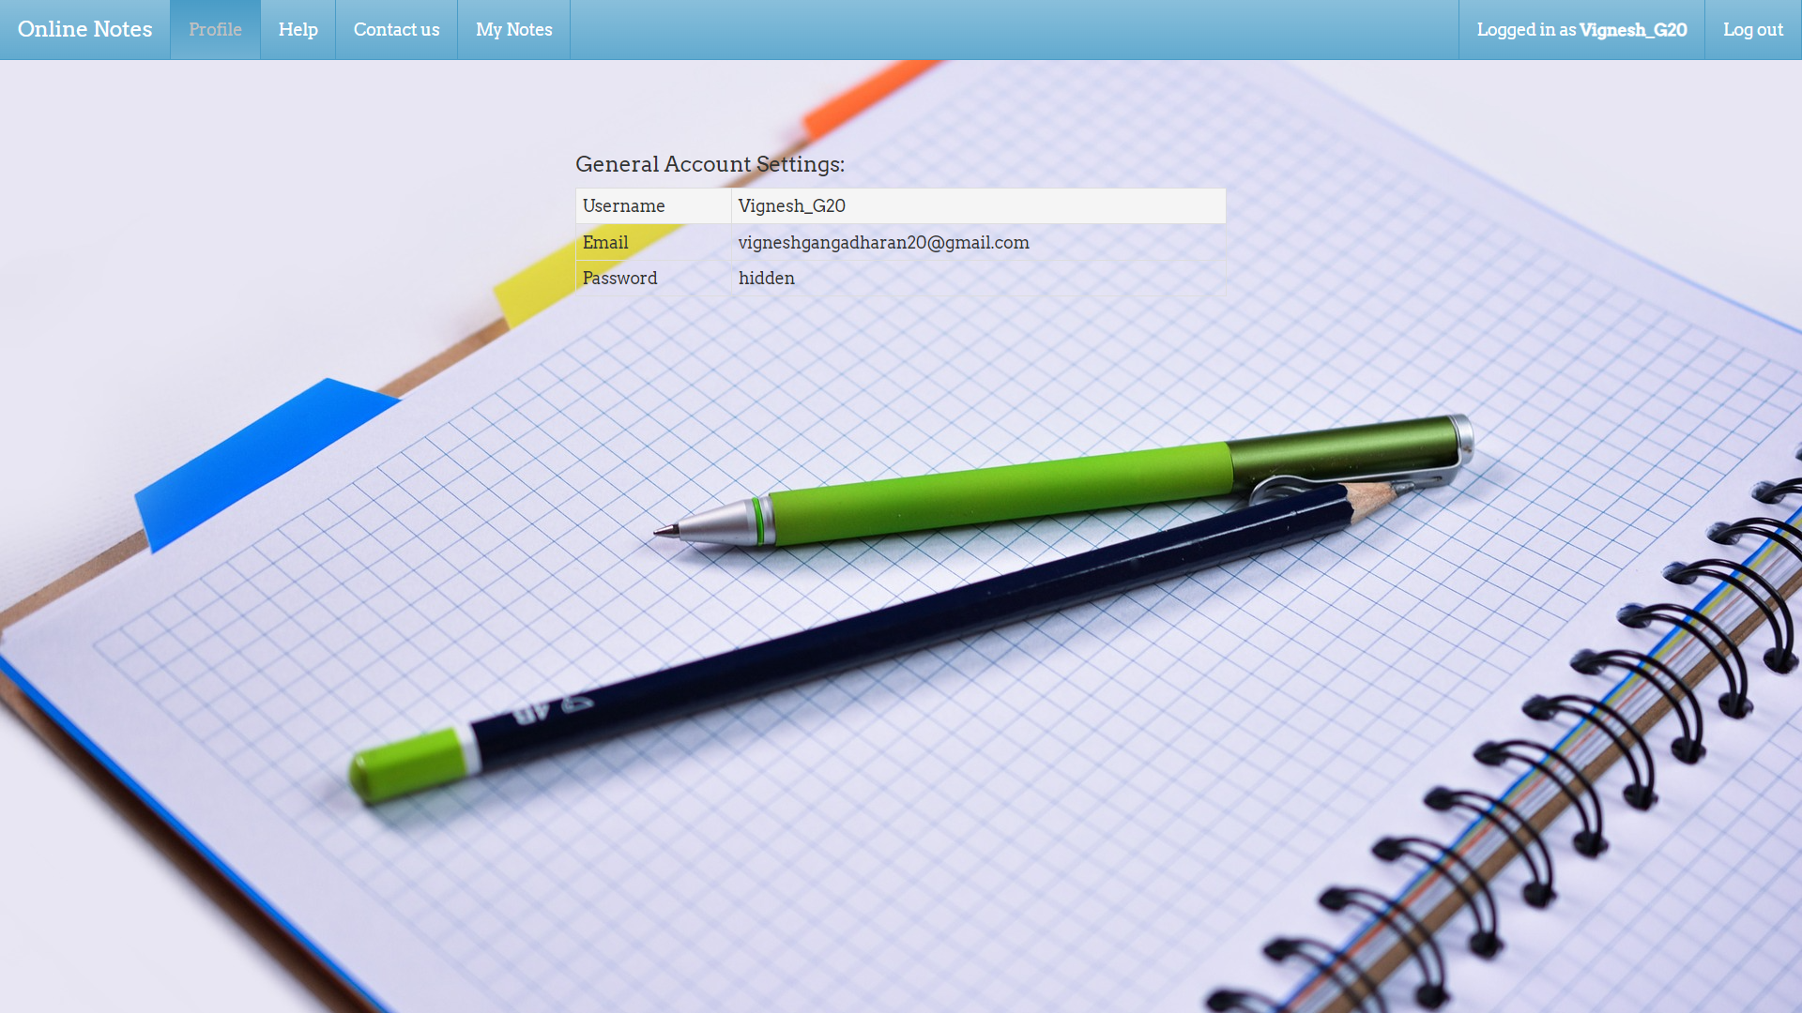
Update Profile
Users can update their email, username, and password from the profile settings page.
This ensures that users have control over their personal information and can keep their account secure and up to date.
The process is straightforward, allowing users to modify their credentials without hassle.

Slide 9
Security Features
Password Hashing: We convert passwords into a secure hash using SHA-256 before storing them, protecting user credentials from unauthorized access.
CSRF Protection: We implement CSRF tokens to prevent unauthorized actions and ensure that requests are genuine.
SQL Injection Protection: We use prepared statements to safeguard against SQL injection attacks and protect our database integrity.

Slide 10
Future Enhancement
Adding Images to Notes: Users will soon be able to embed images in their notes, making them more versatile and visually appealing.
Implementing Search Functionality: We will add a search feature to help users quickly find specific notes or content, improving usability and efficiency.

Slide 11
Conclusion
Our future plans focus on enhancing the user experience with the addition of image embedding in notes and the implementation of a search functionality.
These updates will improve the versatility and usability of our platform, ensuring a more efficient and engaging experience for our users.

Slide 12
Thank you

